Slide 1

Team 1 - Spring-Alert
Initial Presentation Iteration 2 - User Management & Notification Management
Refer: https://github.com/BUMETCS673/project-teamfirst for our latest files and minutes
Notes:
Our vision as driven by Jordany was that we would combine with the other groups for the purpose of providing various microservices that would all later be coupled together to provide a larger offering. As a team we took on the User management & Notification Management system.

Slide 2
Iteration 2 Overview
Refine requirements
Core Infrastructure and architecture design
Building out User Management and Notification Service including unit tests
Integration tests for User Management & Notification Service
Commencing on STD and keeping records of testing metrics
CockroachDB for interaction with PostgresSQL for both services
Set up OAuth2 authentication with Auth0.
Integrate with all Teams for Auth0
Notes:
Either Sherry or Jim to present for slide 1 & 2 and then hand to Jordany

Slide 3
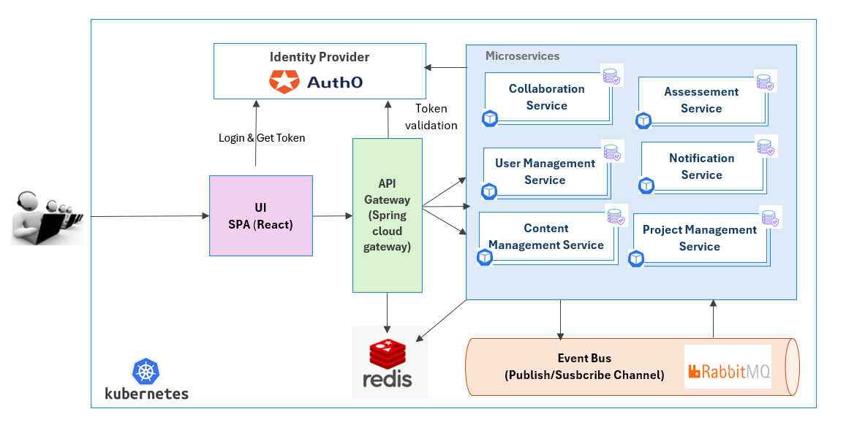
Software Architecture : Updated High Level Design
Notes:
For Jordany: UI will call back end services, note that Redis is no longer in scope of project. We have worked on User Management end points and now moving on to Notification Service

Slide 4
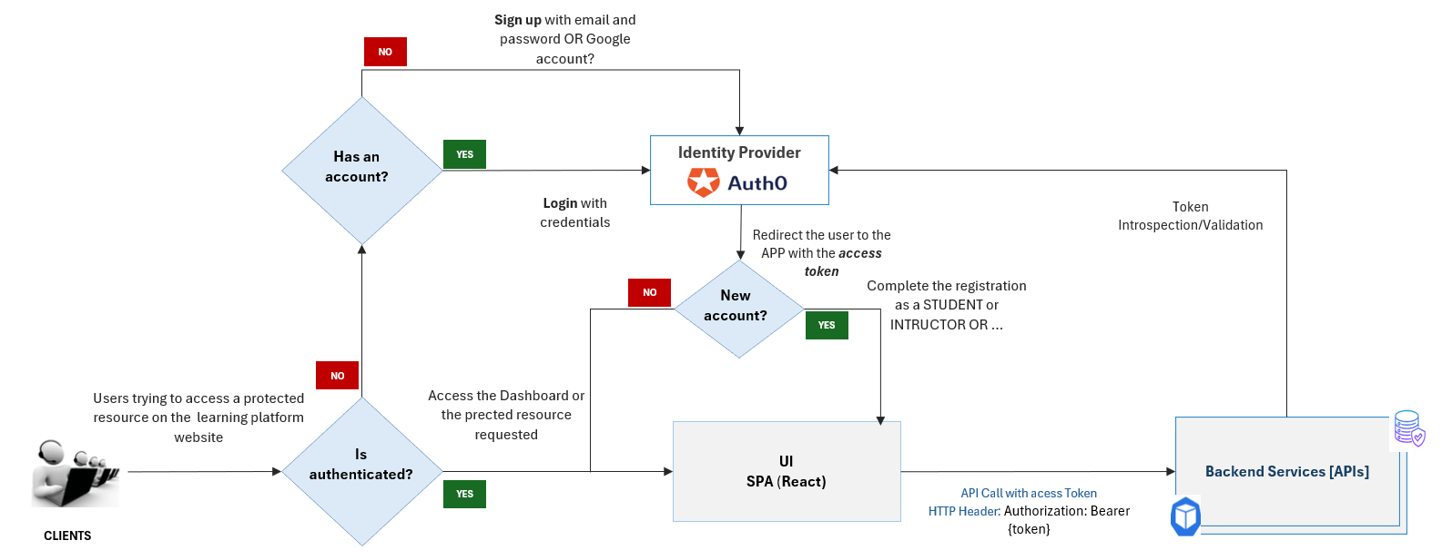
Software Architecture : Continued
Notes:
Jordany to discuss the new account procedure here

Slide 5
Demos

Slide 6
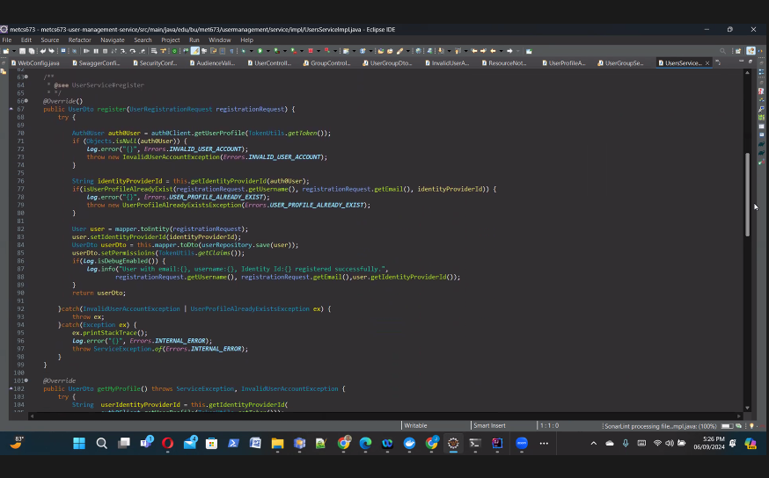
Coding Example: IndentityProviderId
Notes:
Jordany to discuss the logic re: where user already exists or where we have a new user set up.

Slide 7
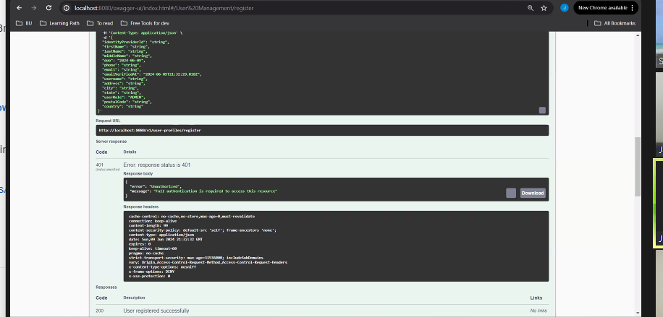
Identifying errors & addressing: Overview
Notes:
Jordany to explain the IdentityProviderID issues and addressing the error with some code amendment.

Slide 8
Next Steps：
Key features：
Build out user tests
Integration Testing
Send notification to group member
Tasks：
Work on integration tests further via mockito
Integrate permission setting with group
Implement backend logic for storing preferences in PostgreSQL
Integrate with RabbitMQ for delivering notifications through chosen channels.
Integrate group feature with notification service
Store notifications in PostgreSQL
Unit tests
Test end-to-end functionality.

